Slide 1
CS174A Lecture 15

Slide 2
Announcements & Reminders
3/06/24: A4 due; will be discussed during this week’s TA session
3/07/23: Prof Demetri’s presentation (Zoom, no recording)
Team Project Timelines: see project info document on Canvas
Team project grade increased from 150 to 175 (download latest team project info)
3/19/24: Final exam, 6:30-8:15 PM, in person, location TBD
Final exam grade reduced from 150 to 125 (download latest syllabus)
Study guide and book exercises posted
3/18 & 3/19: Office hours, Noon-1PM

Slide 3
TA Session This Friday
Team project
Shading, Illumination, Mapping, Shadows, RT exercises

Slide 4
Last Lecture Recap
Hidden Surface Removal
Ray casting

Slide 5
Next Up
Ray Tracing
Issues: speed, shadows, aliasing
Stochastic ray tracing
Prof Demetri: Biometric Human Simulation
Transparent Objects, Compositing
Particle Rendering
Volume Rendering

Slide 6
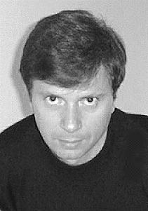
Prof Demetri Terzopoulos
Demetri Terzopoulos is Distinguished Professor and Chancellor's Professor of Computer Science at the University of California, Los Angeles, where he directs the UCLA Computer Graphics & Vision Laboratory. He is also Co-Founder and Chief Scientist of VoxelCloud, Inc. He is or was a Guggenheim Fellow, a Fellow of the Association for Computing Machinery (ACM), a Fellow of the Institute of Electrical and Electronics Engineers (IEEE), a Fellow of the Royal Society of London, a Fellow of the Royal Society of Canada (RSC), and a member of the European Academy of Sciences (EAS), the New York Academy of Sciences (NYAS), and Sigma Xi.
Prof Demetri Bio

Slide 7
Ray Tracing: Issues
Self shadowing due to numerical precision (surface acne)
Similarly for reflection and refraction rays
Issues due to backward ray tracing
Shadow rays not refracted through transparent medium
Shadow rays not reflected off of reflective surfaces like mirror

Slide 8
Ray Tracing: Aliasing
Aliasing in RT
Spatial aliasing
Temporal aliasing: for small objects
Anti-Aliased Ray Tracing
Super-sampling (eye has 5M photoreceptors, while HD has approximately 2M pixels)
Adaptive super-sampling (along edges of objects)
Stochastic RT

Slide 9
Stochastic Ray Tracing
AKA Distributed Ray Tracing
Antialiasing: distribute over pixel sampling area
Gloss: distribute reflected rays
Translucency: distribute refracted rays
Penumbra: distribute shadow rays
Depth of Field: distribute over lens diameter
Motion Blur: distribute across frames

Slide 10
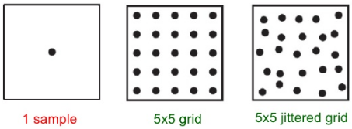
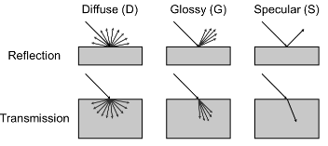
Stochastic Ray Tracing

Slide 11
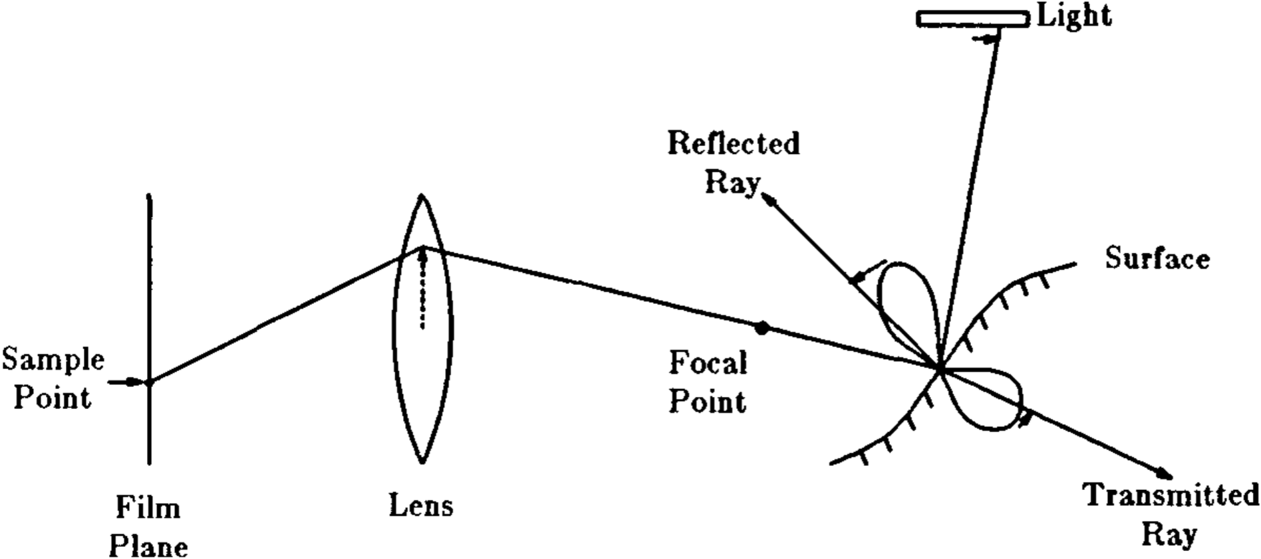
Stochastic Ray Tracing

Slide 12
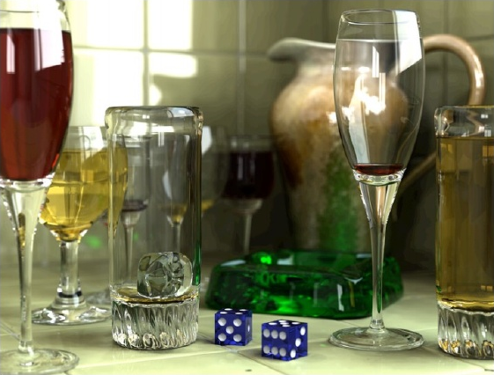
Stochastic Ray Tracing

Slide 13
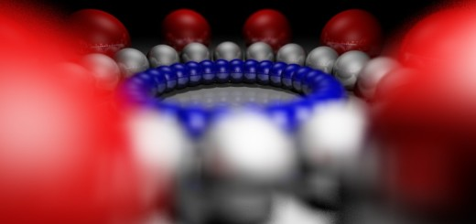
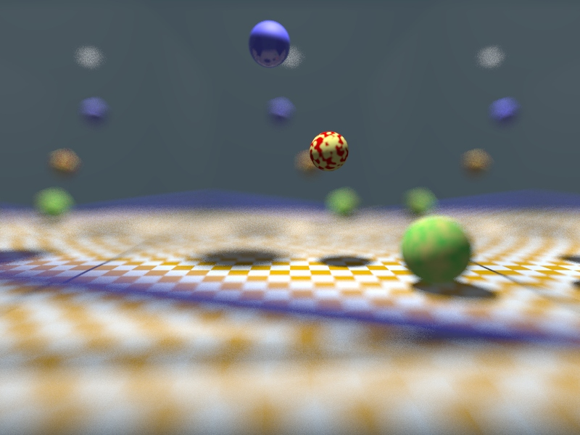
Stochastic Ray Tracing: Depth of Field

Slide 14
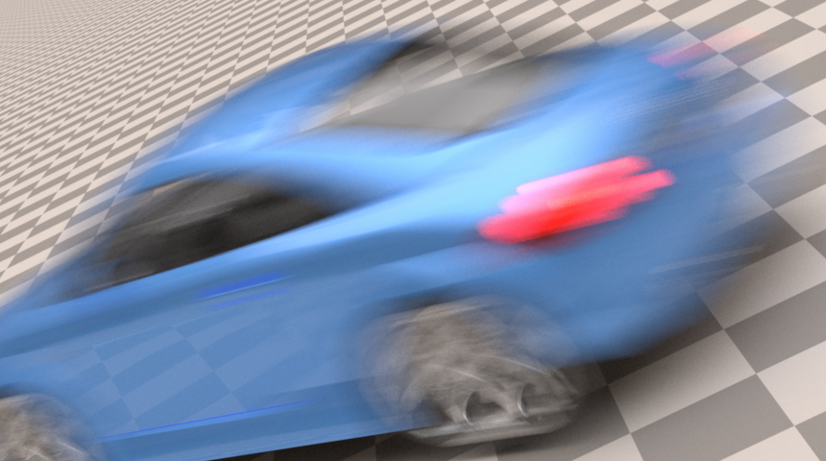
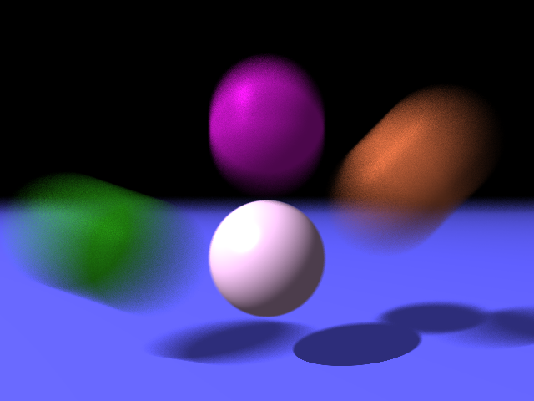
Stochastic Ray Tracing: Motion Blur

